Slide 1
CWO 2 Training
Onderdelen

Slide 2
De vlet zelf
______________
______________
______________
______________
______________
______________
______________
______________
______________
______________
______________
______________
______________
10

Slide 3
Binnenkant van de vlet
____________
____________
____________
____________
____________
____________
____________
____________
____________
____________
____________
____________
____________

Slide 4
Schoten en Stagen
1
2
______________
______________
______________
______________
______________
______________
______________
______________
______________
______________
______________
______________
______________
______________
______________
12
9
8
3
7
10
4
14
13
6
5
15
11

Slide 5
Bovenin de mast
___________________
___________________
___________________
___________________
___________________
___________________
___________________
___________________
___________________
___________________

Slide 6
Zeilen
______________
______________
______________
______________
______________
______________
______________
______________
______________
______________
______________
______________
______________
______________
______________
______________
______________
______________
______________
______________
______________
______________

Slide 7
Haken, Ogen, Bouten
11
11
______________
______________
______________
______________
______________
______________
______________
______________
______________
______________
______________
10
10

Slide 8
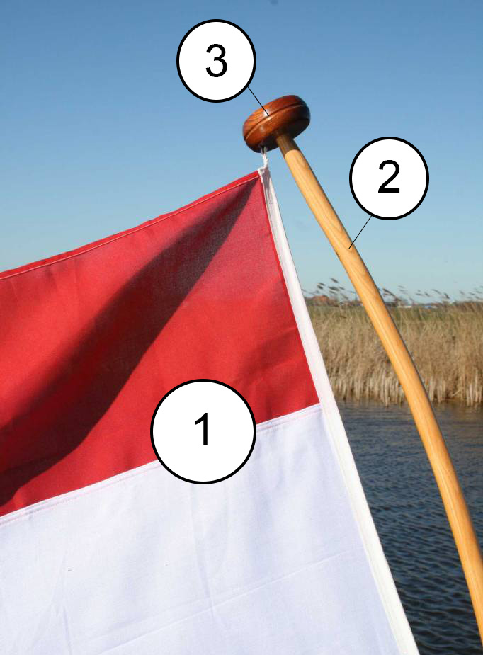
Roer en Vlag
_______________
_______________
_______________
_______________
___________
___________
___________

