Slide 1
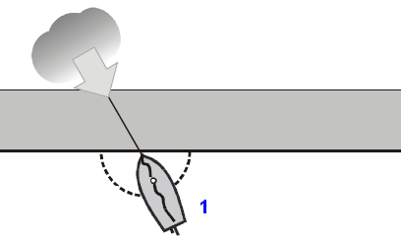
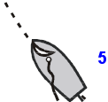
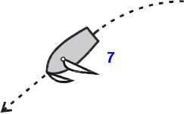
Afvaren hogerwal
______________________________________________________________________________________________
______________________________________________________________________________________________
______________________________________________________________________________________________
______________________________________________________________________________________________
______________________________________________________________________________________________
______________________________________________________________________________________________
______________________________________________________________________________________________

Slide 2
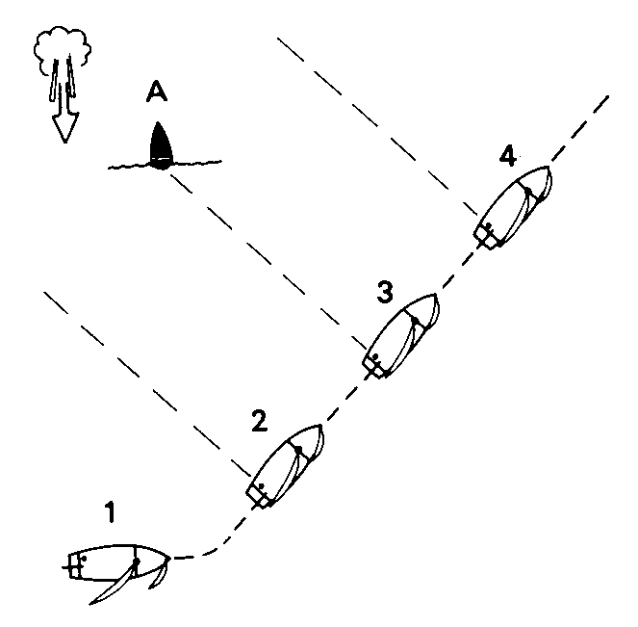
De Dwarspeiling
__________________________________________________________________________________________________________________________
__________________________________________________________________________________________________________________________
__________________________________________________________________________________________________________________________
__________________________________________________________________________________________________________________________
Waar moet je op letten bij het bepalen van het punt waarop je overstag gaat, en waarom?
_________________________________________________________________________________________________________________________________

